Slide 1

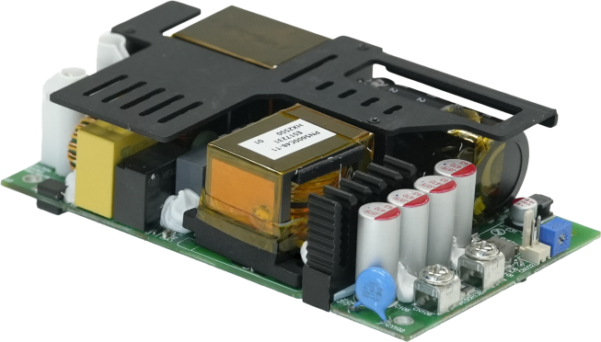
Model: BPA-PNS600
AC/DC Power Series for Industrial/Medical Application
Highlight
Cost effective
360W max convection cooled
600W max air force cooled
900W Peak power
90V-264Vac universal input range
3”x5”x1.3” compact size
-20℃-70℃ operation temperature range
Build-in active PFC
12V/0.5A power for fan
5000m operation altitude
Medical grade 2xMOPP isolation
Support semi-custom design
Optional CLASS II Version
Optional conformal coating
Typical Application
Product Overview
The BPA-PNS600 is a low cost, highly reliable, compact, 600W AC to DC, single output power supply module. With a full range input of 90-264VAC, this power supply module achieves the highest performance and efficiency by incorporating digital control technology.
Custom controls available.
General purpose industrial equipment
Medical equipment
Printers Motor Drives
Key Specification
Model | BPA-PNS600C12 | BPA-PNS600C15 | BPA-PNS600C24 | BPA-PNS600C30 | BPA-PNS600C36 | BPA-PNS600C48
Output voltage | 12V | 15V | 24V | 30V | 36V | 48V
Rated Current @ Convection cooled | 0-30A | 0-24A | 0-15A | 0-12A | 0-10A | 0-7.5A
Rated Current @ 25CFM Air force cooled | 0-50A | 0-40A | 0-25A | 0-20A | 0-16.6A | 0-12.5A
Rated Power | 360W @ Convection Cooled, 600W @ 25CFM Air force cooled
Peak Power | 900W @ 25CFM air force cooled
Dimension | 3”x5”x1.3” or 76.2mmx127mmx33mm
EMC | Class B Emissions. Compliance with IEC60601-1-2 4th edition
Ordering Model Name
BPA-P | N | S | 600 | C | 24 | □□
Series Name | Package Type N: Open Frame Natural Cooled | Outputs S: Single output | Rated Power 600:600W | Connector Type C: Connector | Output Voltage | Control Code AA: Default for Standard model
Note: for any custom design and model name, please consult with BluTek Power, Inc.
Phone: (973) 594-1800 Salesteam@BluTekPower.com
All parameters are set at 25℃ ambient unless other specified. Version A02, Jan, 2026
Confidential, Copyright reserved by BluTek Power, Inc.

Slide 2
Model: BPA-PNS600
AC/DC Power Series for Industrial/Medical Application
Input Specification
Function | Minimum | Typical | Maximum | Condition
Rated Input Voltage | 100Vac |  | 240Vac
Input Voltage Range | 90Vac |  | 264Vac
Input Frequency | 47Hz | 50 / 60Hz | 63Hz
Input Current |  |  | 8A | With rated input voltage
Power Factor | 0.95 |  |  | With max rated output power
Peak Efficiency (exclude fan power) |  |  | 93.5% | 12V model @ 230Vac
 |  |  | 93.5% | 24V model @ 230Vac
 |  |  | 94% | 36V model @ 230Vac
 |  |  | 94% | 48V model @ 230Vac
Inrush Current |  |  | 45A | 240Vac, cold start
Input surge voltage |  |  | 300Vac | last for 1second
Output Specification
Function | Minimum | Typical | Maximum | Condition
Output Voltage Trim Range | 12V | 12V | 12.5V | 12V Model
 | 15V | 15V | 15.5V | 15V Model
 | 24V | 24V | 26V | 24V Model
 | 28V | 30V | 32V | 30V Model
 | 32.4V | 36V | 38V | 36V Model
 | 48V | 48V | 52.8V | 48V Model
Initial Tolerance |  |  | ±0.5% | Trim in factory
Total Regulation |  |  | 3% | Include line and load regulation
Output Ripple |  |  | 1% | Peak-Peak value, full load measure at board end with 0.1uF Ceramic and 47uF electrolytic capacitor, 20MHz BW
Dynamic Response |  |  | 5% | with 50% load step
Capacitive Load |  |  | 1000uF
Power up time |  |  | 2s
Rise time |  |  | 50ms | without cap load
Hold up time | 20ms |  |  | 115Vac/60Hz input @ 300W load
Protection Specification
Function | Minimum | Typical | Maximum | Condition
Input under voltage |  | TBD |  | Auto-restart after fault is removed
Over current protection (OCP) |  |  |  | Auto-restart, Clamp by constant current
Short circuit protection (SCP) |  |  |  | Auto-restart after fault is removed
Over voltage protection (OVP) |  |  | 130% | Latch off
Over temperature protection (OTP) |  |  |  | Auto-restart
*Protection mode latch or auto-restart can be customized, contact BluTek Power, Inc. for more details.
Fan Output Specification
Function | Minimum | Typical | Maximum | Condition
Output voltage | 11.64V | 12V | 12.36V | 0-0.5A
Over current protection (OCP) | 1A |  |  | Auto-restart after fault is removed
Short circuit protection (SCP) |  |  |  | Auto-restart after fault is removed
Phone: (973) 594-1800 Salesteam@BluTekPower.com
All parameters are set at 25℃ ambient unless other specified. Version A02, Jan, 2026
Confidential, Copyright reserved by BluTek Power, Inc.

Slide 3
Model: BPA-PNS600
AC/DC Power Series for Industrial/Medical Application
Reliability
Function | Minimum | Typical | Maximum | Condition
MTBF | 500Khrs |  |  | According to Telecordia SR-332. 115Vac 25℃ ambient with rated load
Life | 5 years |  |  | Rated nominal conditions
EMC
Conducted Emissions | EN 55011 / EN 55032,Class B
Radiated Emissions | EN 55011 / EN 55032,Class B
Harmonic Current Emissions | IEC 61000-3-2 Meet Class D limit
Voltage Flicker | IEC 61000-3-3
Electrostatic Discharge | IEC 61000-4-2 Level 4 (Air Discharge: 15 kV,Contact Discharge: 8 kV) Criteria A
Radiated Field | IEC 61000-4-3 Criteria A
Electrical Fast Transient / Burst | IEC 61000-4-4 Level 3 (2 kV),Criteria A
Surge | IEC 61000-4-5 Level 3 (Common Mode 2kV, Differential Mode 1kV), Criteria A
CS | IEC 61000-4-6 Level 2 (150 kHz-80 MHz, 3 Vrms, 6 Vrms at ISM bands and Amateur radio bands), Criteria A
Power Frequency Magnetic Fields | IEC 61000-4-8 Criteria A,Magnetic field strength 30 A/m
Voltage Dips | IEC 61000-4-11 30% 10 ms Criteria A 60% 100 ms Criteria B 100% 5000 ms Criteria B
Voltage Dips | IEC 60601-1-2 Criteria A @ 80% W or lower 0% UT, 0.5 cycle(10 ms) (0°,45°,90°,135°,180°,225°,270°,315°,360°) Criteria B ,can meet Criteria A with 50% load or lower 0% UT,1 cycle (20 ms), 0° Criteria B 70% UT,25 cycle (500 ms) , 0° Criteria A for Medical models only 70% UT,25 cycle (500 ms) , 0° with 50% Load or lower Criteria B 0% UT,250 cycle (5000 ms) , 0°
Criteria A: Normal operation within spec limit
Criteria B: Out of regulation or restart to normal operation after test
Safety / Directives
Medical Safety * |  | IEC 60601-1 3rd+A1 edition TUV EN 60601-1:2006 UL 60601-1+CAN/CSA 60601-1: (Ed.3.2005)
ITE Safety * |  | IEC 62368-1 UL 62368-1+CAN/CSA 62368-1 GB 4943.1-2022, GB/T 9254.1-2021, GB 17625.1-2022
CE * |  | EMC Directive 2014/30/EU and Low Voltage Directive 2014/35/EU EN 60601-1: 2006 + A11: 2011 + A1: 2013 + A12: 2014 & EN 60601-1-2: 2015
UKCA * |  | In conformance with Electrical Equipment (Safety) Regulations 2016, and Electromagnetic Compatibility Regulations 2016, Medical Devices Regulations 2002 (UK MDR 2002)
Dielectric Voltage | Input to/Output | 4000Vac (2XMOPP)
 | Input to/Ground | 1800Vac (1XMOPP)
 | Output to/Ground | 1500Vac (1XMOPP)
*Compliance only, contact BluTek Power, Inc. for detailed safety certifications
Phone: (973) 594-1800 Salesteam@BluTekPower.com
All parameters are set at 25℃ ambient unless other specified. Version A02, Jan, 2026
Confidential, Copyright reserved by BluTek Power, Inc.

Slide 4
Model: BPA-PNS600
AC/DC Power Series for Industrial/Medical Application
Environmental
Function | Min | Typical | Max | Condition
Operation Temperature | -20℃ |  | 70℃ | See power derating curve
Operation Humidity | 10% |  | 90% | Non-condensing
Storage Temperature | -40℃ |  | 70℃
Storage Humidity | 10%RH |  | 90%RH | Non-condensing
Operation Altitude |  |  | 5000m or 16,405 feet
Shock |  |  | 196m/s2 | Base mounted
Vibration |  |  | 19.6m/s2 | 10-55Hz 1 Hour for each axis. Base mounted
Leakage Current
Function | Min | Typical | Max | Condition
Input-PE Leakage |  |  | 300uA | 264Vac/50Hz Normal Condition
Operation Humidity |  |  | 1mA | 264Vac/50Hz Single Fault Condition
Output-PE Leakage （Meet Type BF application for IEC60601-1） |  |  | 100uA | 264Vac/50Hz Normal Condition
 |  |  | 500uA | 264Vac/50Hz Single Fault Condition
Output Power De-rating Curve
600W
Convection cooled @ 230VAc
360W
Convection cooled @ 115VAc
300W
Fan cooled
240W
-20
60
70
40
50
Temperature(℃)
30
BPA-PNS600 power derating curve vs temperature
100%
Output Power
80%
85
115
264
Input Voltage (VAC)
BPA-PNS600 power derating curve vs input voltage
Phone: (973) 594-1800 Salesteam@BluTekPower.com
All parameters are set at 25℃ ambient unless other specified. Version A02, Jan, 2026
Confidential, Copyright reserved by BluTek Power, Inc.

Slide 5
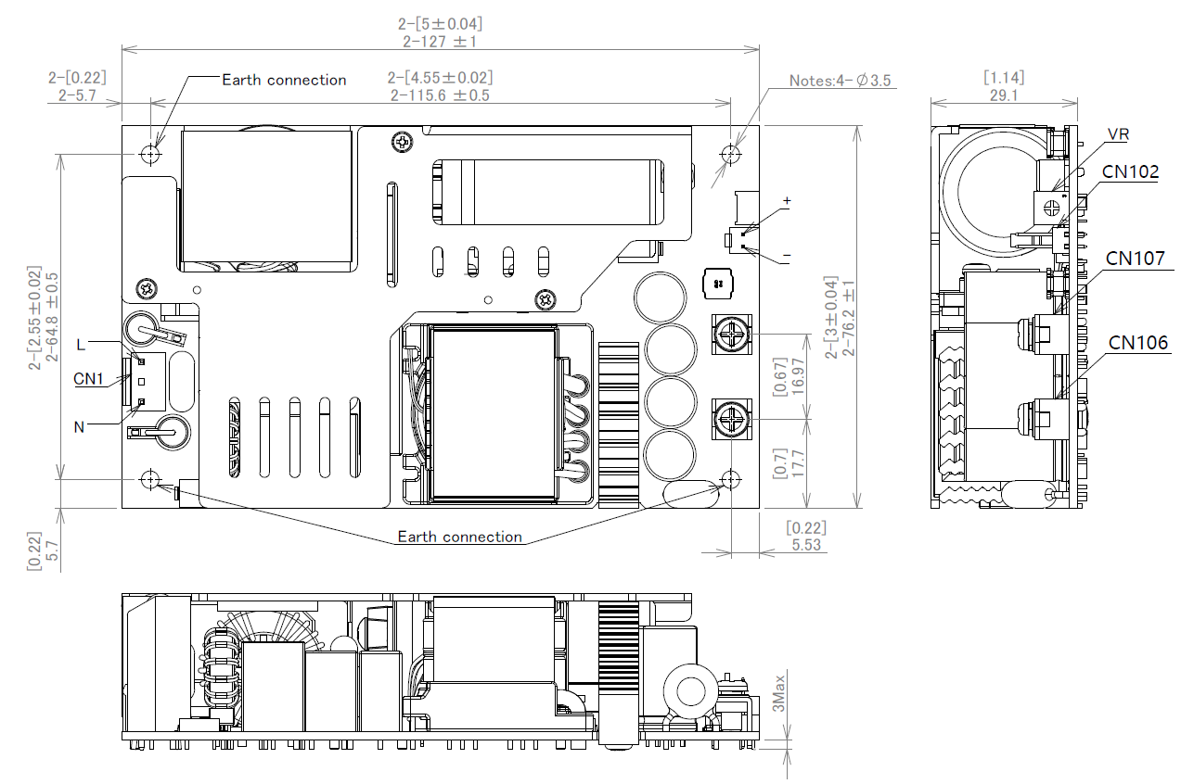
Model: BPA-PNS600
AC/DC Power Series for Industrial/Medical Application
Mechanical Drawing
Notes:
1. Mounting with M3 screws.
2.In Class I applications, the mounting hole marked "Earth connection" shall be fastened to the protective earth (PE) using metal screws to ensure the system design complies with relevant safety regulatory requirements.
3.CN1 is the input connector.
4.CN106 and CN107 are output connectors.
5.CN102 is the fan power supply connector.
Phone: (973) 594-1800 Salesteam@BluTekPower.com
All parameters are set at 25℃ ambient unless other specified. Version A02, Jan, 2026
Confidential, Copyright reserved by BluTek Power, Inc.

Slide 6
Model: BPA-PNS600
AC/DC Power Series for Industrial/Medical Application
Connector and Pin Assignment
Position | Connector / Connection | Maximum Condition
Input Connector CN1 | Mating with JST VHR-3N | 240Vac
Input Voltage Range | Pin Number | Function
Input Frequency | L | Line
Input Current | N | Neutral
Fan Connector CN102 | Mating with Molex 511910200
 | Pin Number | Function
 | + | Positive
 | - | Return
Position | Connector / Connection | Maximum Condition
Output Connector | Output terminal blocks, M3.5 Screw | 240Vac
Input Voltage Range | Designator | Function
Input Frequency | CN106 | Output positive
Input Current | CN107 | Output return
Phone: (973) 594-1800 Salesteam@BluTekPower.com
All parameters are set at 25℃ ambient unless other specified. Version A02, Jan, 2026
Confidential, Copyright reserved by BluTek Power, Inc.

Slide 7
Model: BPA-PNS600
AC/DC Power Series for Industrial/Medical Application
Voltage Trimming
Auxiliary Power Supply
The power supply provides a potentiometer for user to adjust the output voltage. Switch the potentiometer clockwise to increase the output voltage, switch the potentiometer counterclockwise to decrease the output voltage.
Please reference to Output Specification for the output voltage range which user shall trim the voltage within.
When the output is adjusted below nominal value, the maximum output current is the same as the nominal output, when the output is adjusted above nominal value, the output power cannot exceed the nominal maximum power (the maximum output current used should be reduced accordingly).
An additional 12V 0.5A power supply is provided. It can be used as fan power. Please note this voltage is not isolated from main output.
Phone: (973) 594-1800 Salesteam@BluTekPower.com
All parameters are set at 25℃ ambient unless other specified. Version A02, Jan, 2026
Confidential, Copyright reserved by BluTek Power, Inc.

