Slide 1

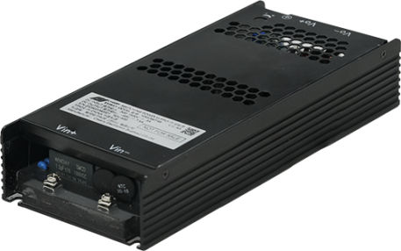
Model: BPD-HNS360
High Voltage DC/DC for Solar/ESS Application
Highlight
Cost effective
360W max continuous output
300V – 1500V wide input range
100mm x 237mm x 43mm compact size
Convection cooled
Long holdup time
-20℃-70℃ operation temperature range
LED DC_OK indication
DC_OK analog indication signal
Active current sharing support
Support semi-custom design
Typical Application
Product Overview
The BPD-NHS360 is a highly reliable, compact, 360W wide Input range, DC to DC, single output power supply module. With a full range input of 300-1500VDC, this power supply module achieves the highest performance and efficiency by incorporating digital control technology..
Custom controls available.
Solar tracking system
ESS application
Key Specification
Model | BPD-HNS360T24 | BPD-HNS360T36 | BPD-HNS360T48
Output voltage | 24V | 36V | 48V
Rated Current | 0-15A | 0-10A | 0-7.5A
Rated Power | 360W
Dimension | 100mm x 237mm x 43mm
EMC | CLASS B emission
Ordering Model Name
BPD-H | N | S | 360 | T | 24 | □□
Series Name | Package Type N: Natural Cooled | Outputs S: Single output | Rated Power 360W | Connector Type T: Screw terminal | Output Voltage | Control Code AA: Default for Standard model
Note: for any custom design and model name, please consult with BluTek Power, Inc.
Phone: (973) 594-1800 Salesteam@BluTekPower.com
All parameters are set at 25℃ ambient unless other specified. Version A04, Feb, 2026
Confidential, Copyright reserved by BluTek Power, Inc.

Slide 2
Model: BPD-HNS360
High Voltage DC/DC for Solar/ESS Application
Input Specification
Function | Minimum | Typical | Maximum | Condition
Input Voltage Range | 300VDC |  | 1500VDC
Input Current |  |  | 3A | @300VDC Input
 |  |  | 0.6A | @1500VDC Input
Peak Efficiency |  |  | 91%
Inrush Current |  |  | 300A | 1500Vdc, cold start
Input surge voltage |  |  | 1700VDC | last for 1second
Fuse Required | 4A |  |  | Must be installed externally
Output Specification
Function | Minimum | Typical | Maximum | Condition
Output Voltage Trim Range | 24V | 24V | 28V | 24V Model
 | 30V | 36V | 36V | 36V Model
 | 42V | 48V | 54V | 48V Model
Output Power | 0W |  | 360W
Initial Tolerance |  |  | ±0.5% | Trim in factory
Total Regulation |  |  | 3% | Include line and load regulation
Output Ripple |  |  | 1% | Peak-Peak value, full load measure at board end with 0.1uF Ceramic and 47uF electrolytic capacitor, 20MHz BW
Dynamic Response |  |  | 5% | with 50% load step, min from 0.1A
Capacitive Load |  |  | 2200uF
Power up time |  |  | 5s | Longest at 300Vdc input
Rise time |  |  | 50ms | without cap load
Hold up time | 30ms |  |  | 1200VDC @ 360W load 750VDC @ 200W load
Protection Specification
Function | Minimum | Typical | Maximum | Condition
Input under voltage |  | 270VDC |  | Auto-restart after fault is removed
Over current protection (OCP) |  |  |  | Auto-restart, Clamp by constant current
Short circuit protection (SCP) |  |  |  | Auto-restart after fault is removed
Over voltage protection (OVP) |  |  | 130% | Auto-restart after fault is removed
Over temperature protection (OTP) |  |  |  | Auto-restart after fault is removed
*Protection mode latch or auto-restart can be customized, contact BluTek Power, Inc. for more details.
Phone: (973) 594-1800 Salesteam@BluTekPower.com
All parameters are set at 25℃ ambient unless other specified. Version A04, Feb, 2026
Confidential, Copyright reserved by BluTek Power, Inc.

Slide 3
Model: BPD-HNS360
High Voltage DC/DC for Solar/ESS Application
Reliability
Function | Minimum | Typical | Maximum | Condition
MTBF | 500Khrs |  |  | According to Telecordia SR-332. 115Vac 25℃ ambient with rated load
Life | 5 years |  |  | Rated nominal conditions
EMC
Conducted Emissions | EN 55011 / EN 55032,Class B
Radiated Emissions | EN 55011 / EN 55032,Class B
Electrostatic Discharge | IEC 61000-4-2 Level 4 (Air Discharge: 15 kV,Contact Discharge: 8 kV) Criteria A
Radiated Field | IEC 61000-4-3 Criteria A
Electrical Fast Transient / Burst | IEC 61000-4-4 Level 3 (2 kV),Criteria A
Surge | IEC 61000-4-5 Level 3 (Common Mode 2kV, Differential Mode 1kV), Criteria A
CS | IEC 61000-4-6 Level 2 (150 kHz-80 MHz, 3 Vrms, 6 Vrms at ISM bands and Amateur radio bands), Criteria A
Power Frequency Magnetic Fields | IEC 61000-4-8 Criteria A,Magnetic field strength 30 A/m
Criteria A: Normal operation within spec limit
Criteria B: Out of regulation or restart to normal operation after test
Safety / Directives
Solar System, ESS |  | IEC62109-1:2010 UL1741
Dielectric Voltage | Input to/Output | 4000Vac
 | Input to/Ground | 4000Vac
 | Output to/Ground | 4000Vac
*Compliance only, contact BluTek Power, Inc. for detailed safety certifications
Phone: (973) 594-1800 Salesteam@BluTekPower.com
All parameters are set at 25℃ ambient unless other specified. Version A04, Feb, 2026
Confidential, Copyright reserved by BluTek Power, Inc.

Slide 4
Model: BPD-HNS360
High Voltage DC/DC for Solar/ESS Application
Environmental
Function | Min | Typical | Max | Condition
Operation Temperature | -20℃ |  | 70℃ | See power derating curve
Operation Humidity | 10%RH |  | 90%RH | Non-condensing
Storage Temperature | -40℃ |  | 70℃
Storage Humidity | 10%RH |  | 90%RH | Non-condensing
Operation Altitude |  |  | 5000m or 16,405 feet
Shock |  |  | 196m/s2 | Duration: 11ms，3 times per axis along ±X, ±Y, and ±Z directions ，non-packaged
Vibration |  |  | 19.6m/s2 | at 3g acceleration,10-500Hz 1 Hour for each axis. Non-package
Output Power De-rating Curve
360W
180W
-20 ℃
50℃
70℃
Power Derating Curve
Phone: (973) 594-1800 Salesteam@BluTekPower.com
All parameters are set at 25℃ ambient unless other specified. Version A04, Feb, 2026
Confidential, Copyright reserved by BluTek Power, Inc.

Slide 5
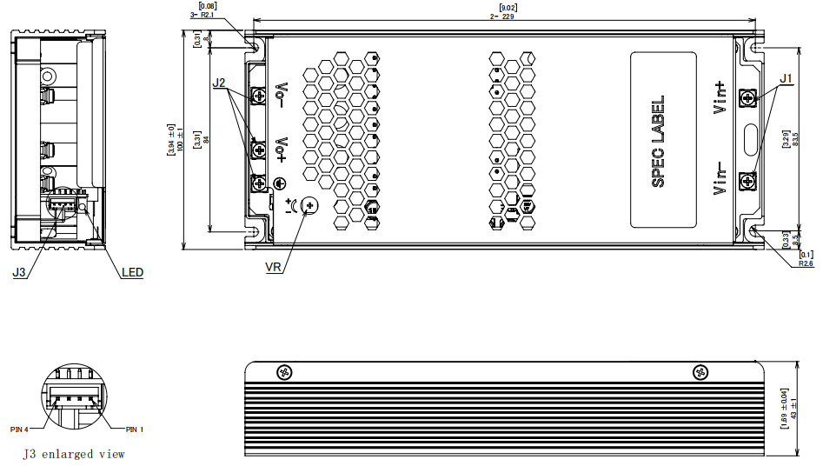
Model: BPD-HNS360
High Voltage DC/DC for Solar/ESS Application
Mechanical Drawing
Notes:
1. J1 is input terminal block, 11.5kgf.cm (10 Lbf.in) rated torque.
2. J2 is output terminal block,11.5kgf.cm(10 Lbf.in) rated torque.
3. VR: clockwise is to increase the output voltage, anti-clockwise is to reduce the output voltage.
4. J3 is control connector
Connector and Pin Assignment
Position | Connector / Connection | Maximum Condition
Input Connector J1 | Input screw terminal connector | 240Vac
Input Voltage Range | Enclosure Mark | Designation
Input Frequency | Vin+ | Input positive
Input Current | Vin- | Input return
Position | Connector / Connection | Maximum Condition
Control Connector J3 | Input screw terminal connector | 240Vac
Input Voltage Range | Pin Number | Designation
Input Frequency | Pin1 | Current Share
 | Pin2 | NC
Input Current | Pin3 | DC OK-
 | Pin4 | DC OK+
Position | Connector / Connection | Maximum Condition
Main Output Connector J2 | Output screw terminal connector | 240Vac
Input Voltage Range | Enclosure Mark | Designation
Input Frequency | Vo+ | Output positive
Input Current | Vo- | DC Output return
Phone: (973) 594-1800 Salesteam@BluTekPower.com
All parameters are set at 25℃ ambient unless other specified. Version A04, Feb, 2026
Confidential, Copyright reserved by BluTek Power, Inc.

Slide 6
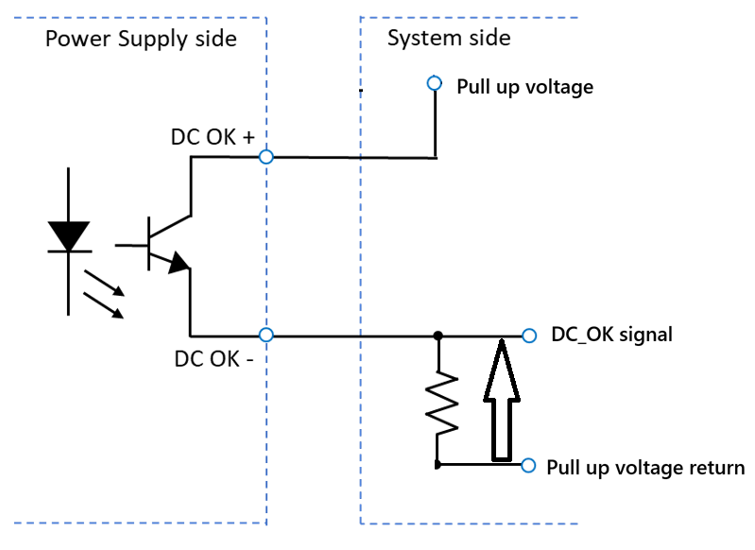
Model: BPD-HNS360
High Voltage DC/DC for Solar/ESS Application
Voltage Trimming
External Fuse
The power supply provides a potentiometer for user to adjust the output voltage. Switch the potentiometer clockwise to increase the output voltage, switch the potentiometer counterclockwise to decrease the output voltage.
Please reference to Output Specification for the output voltage range which user shall trim the voltage within.
When the output is adjusted below nominal value, the maximum output current is the same as the nominal output, when the output is adjusted above nominal value, the output power cannot exceed the nominal maximum power (the maximum output current used should be reduced accordingly).
External fuse must be series with DC input positive line to break circuit, to avoid any hazardous may be caused by fault situation.
Current Sharing
HNS360 series supports current sharing function. Please contact BluTek Power, Inc. for details.
DC_OK Signal
DC_OK Signal is designed to indicate the main DC output status. DC_OK+/- control ports are open pins from a photocoupler inside the PSU, customer needs to build external circuit to get the high or low DC_OK signal. Below figure is one connection suggest, when DC output is present, DC_OK Signal (Shown in below figure) generated will be high. When DC output is off, the internal transistor will be turned off, DC_OK signal will be low.
Phone: (973) 594-1800 Salesteam@BluTekPower.com
All parameters are set at 25℃ ambient unless other specified. Version A04, Feb, 2026
Confidential, Copyright reserved by BluTek Power, Inc.

